Slide 1
Creating an NBA Championship Team Using Data
By: Saif Ansari, Derrick Armstrong, Garrison Boykin, Akhil Katuri, & Kelsey Nyandusi

Slide 2
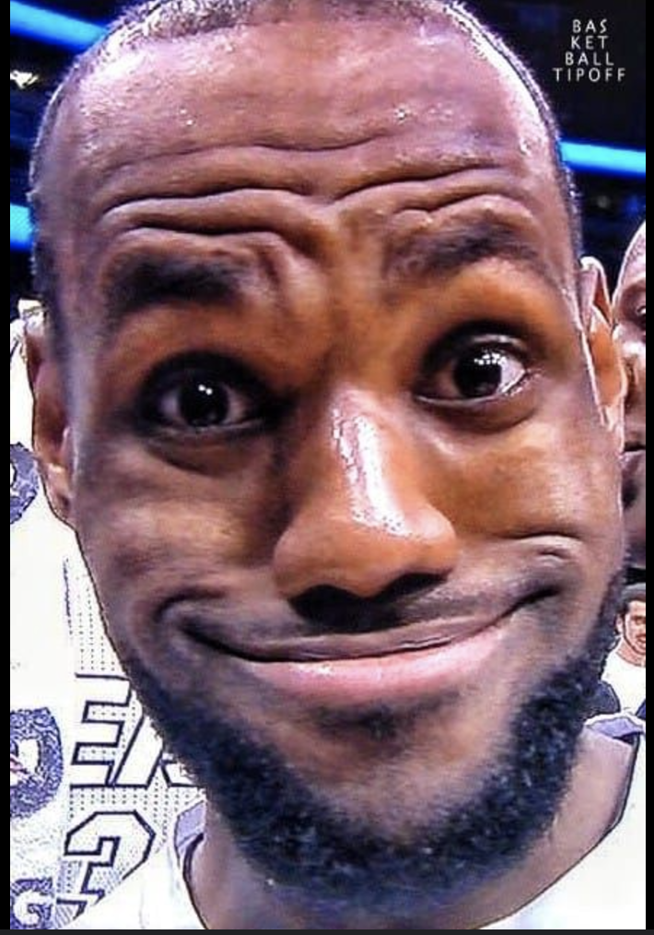






Team LeSunshine
Saif Ansari
Derrick Armstrong
Garrison Boykin
Akhil Katuri
Kelsey Nyandusi

Slide 3
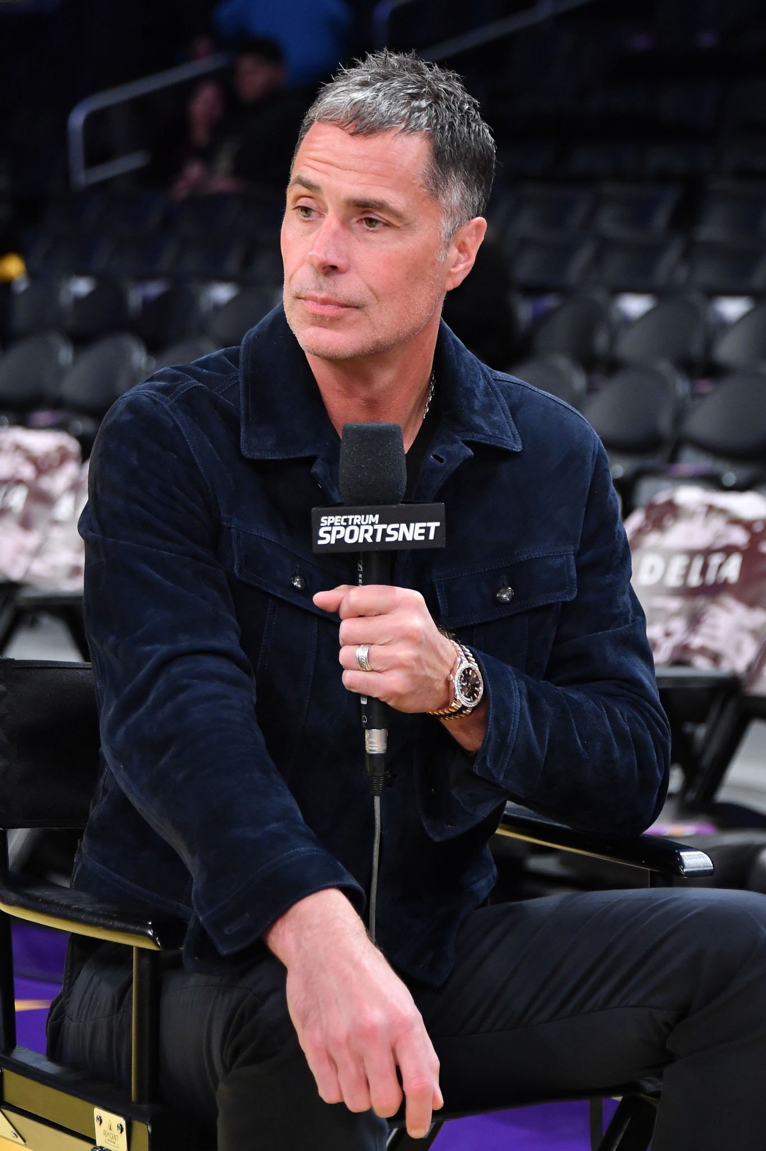

Introduction
Notes:
This is Rob Pelinka, GM of the Los Angeles Lakers
He’s the decision maker when it comes to
signing players
trading players
evaluating draft picks
& finding hidden talent to build a championship roster
2 big questions that linger in his mind: How effective are my players? How much should I pay them?
Our team spent the last few weeks developing tools that he could use to make data driven decisions about how to make important roster choices to ultimately win a championship!

Slide 4
Introduction
Dataset
Data Cleaning
1
Derived from Kaggle
1
Removed Outliers (G, MP)
2
2023-2024 NBA regular season stats
2
Implemented EFF (multicollinearity issues)
3
Salary and Team Info (ESPN)
3
Normalized the data (per36)
Notes:
Removed all players with
less than 5 games played the whole season
played less than 10 minutes per game
implemented a metric called EFF to represent individual player’s efficiency
takes positive stats like points, assists, rebounds
and subtracts negative stats like turnovers and missed shots.
Helps remove multicollinearity
then we created a new metric that normalizes the data per 36 minutes of play

Slide 5
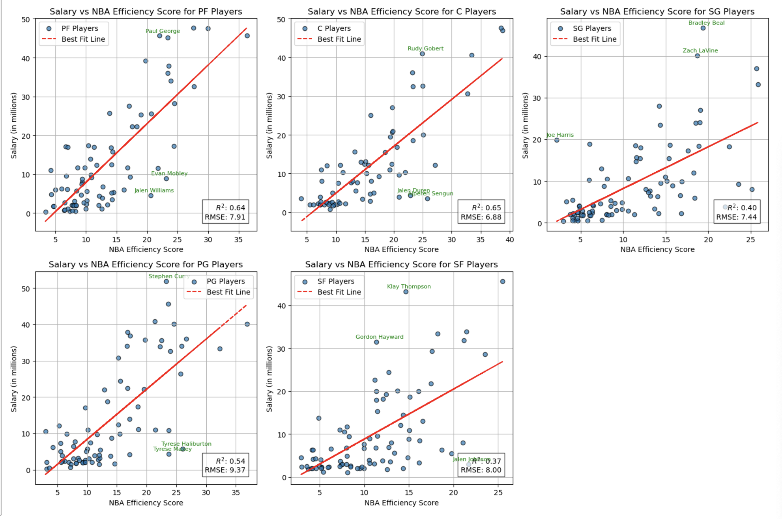
Introduction
Notes:
5 graphs, 1 for each position, Salary vs EFF
Found a positive correlation between the two (which is that the more efficient players get higher salary)
That gave us the confidence to explore the data further and examine the salary efficiency relationship more
Now ill pass on to Saif

Slide 6
Finding #1
The True Drivers of Team Success

Slide 7
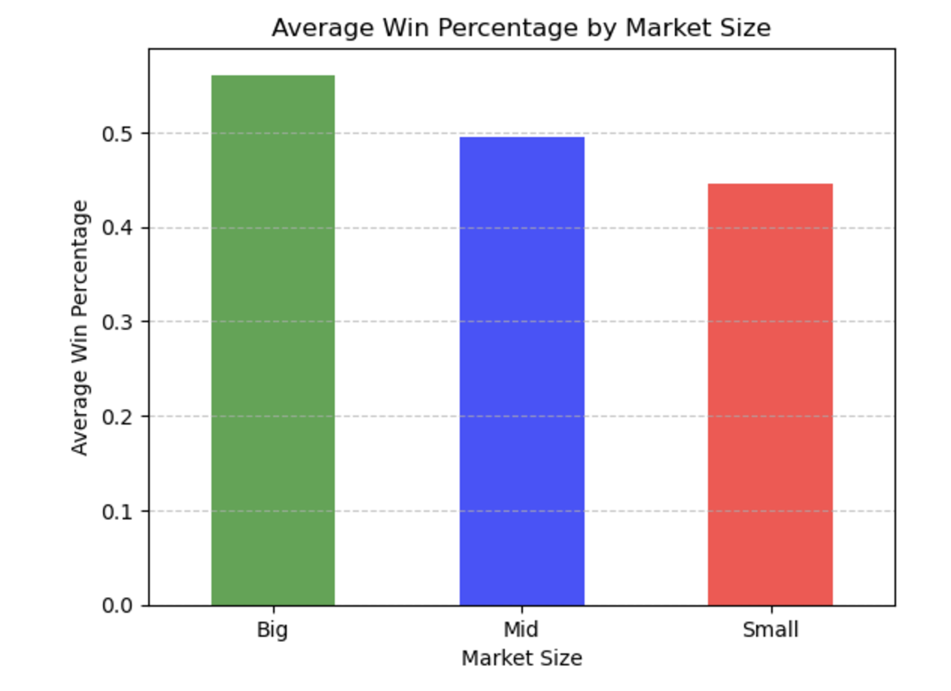
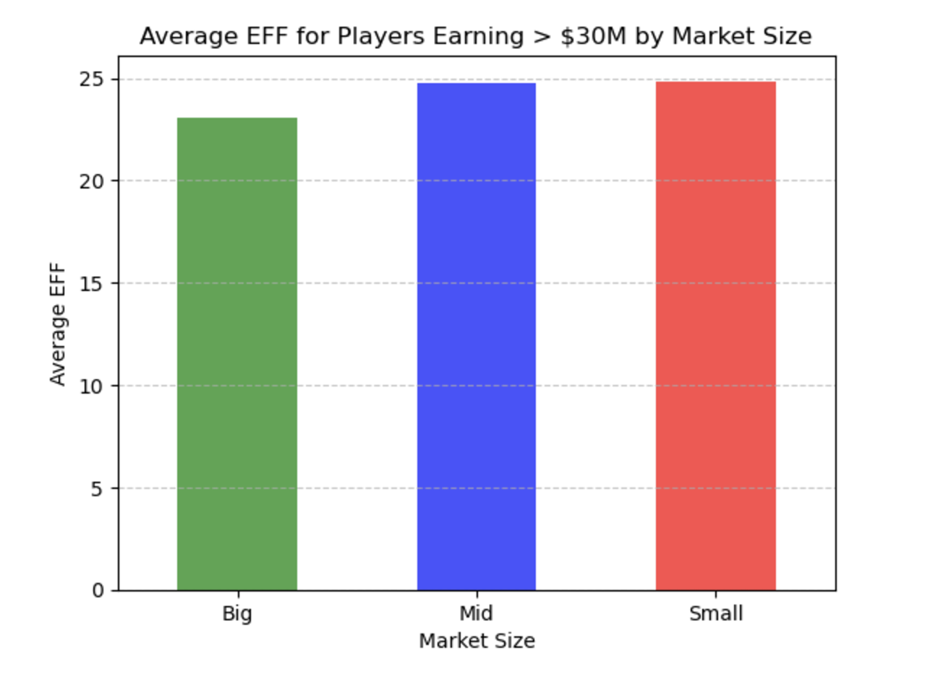
Finding #1
Notes:
(First Graph) Big Markets Have Better Team Performance (Win %):
Average Win Percentage by Market Size
Teams in big markets outperform in terms of win percentage compared to Mid and small markets
(Second Graph) Star Players Perform Consistently Across Markets:
Average EFF for Star Players (usualy the ones earning greater than 30M) by Market Size
High-salary stars ($30M+) perform at similar levels (average EFF) between all of market size. This implies that acquiring stars ensures a baseline level of individual performance, but there are other reasons for win percentages are different in each market of each market

Slide 8
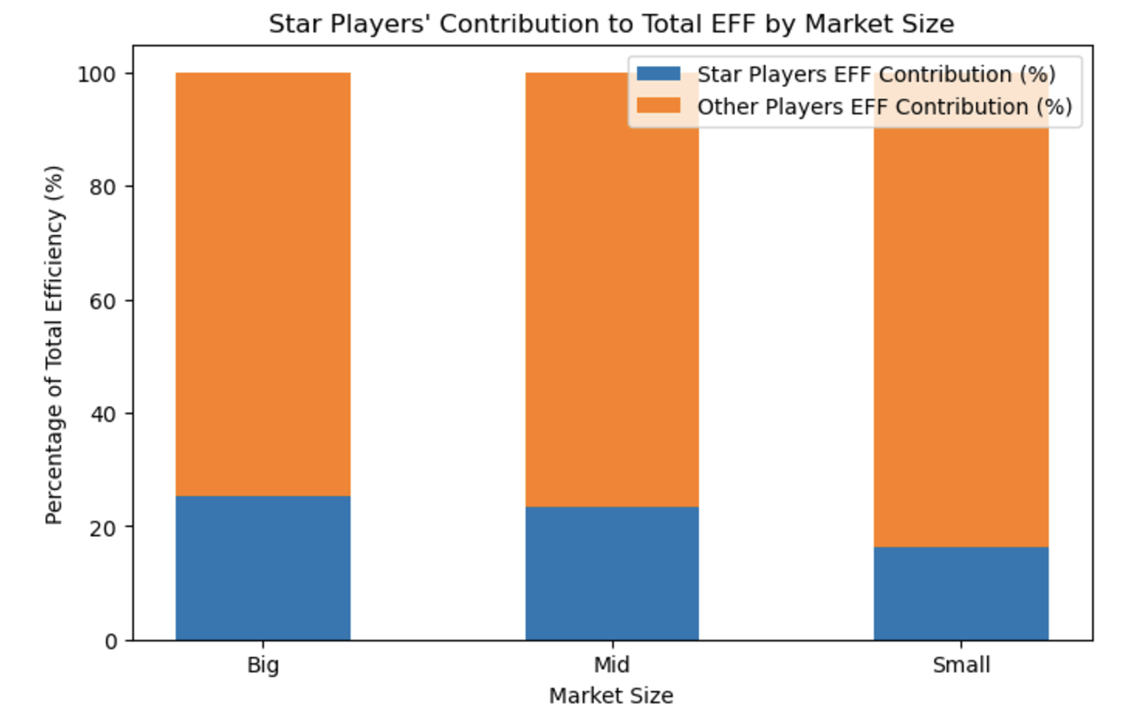
Finding #1
Notes:
Star Players' Contribution:
Across big, mid, and small markets, star players consistently contribute only a small proportion of the total EFF. This highlights that even though star players are high-performing, they are not the sole drivers of team success.
EX: big market should invest more in role players
EX: Mid/Small market should reevaluate the current star players and invest more in role player and overall team instructure

Slide 9
Finding #2
EFF Score For the Rookies

Slide 10
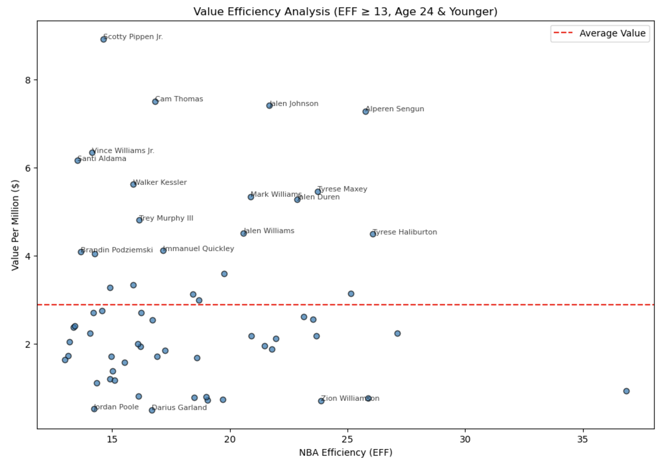
Finding #2

Slide 11
Finding #2
Overview
Use-Case
Looking at players still in their rookie contract
Used by managers in a team to identify whether their players are at risk for being poached by other teams.
Example:
Scottie Pippen Jr. has a very similar efficiency score as compared with Jordan Poole, but is a bigger “bang for the buck” than Jordan is.
Grizzlies might want to watch out! Think long term for Pippen Jr.
1
Players with an EFF >= 13
2
Players with an age <= 24
3
Mean Value per Million = 3
Notes:
EF of 13 or more indicates in the rotation. 24 or younger because average draft pick is 24 and rookie deals are 4 years

Slide 12
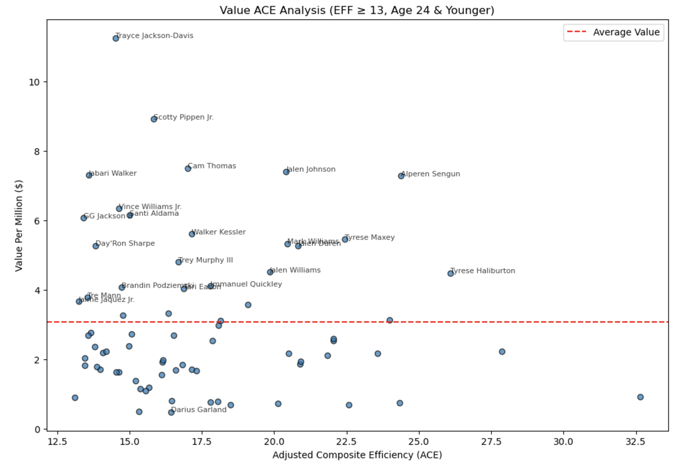
Finding #2

Slide 13
Finding #2
Overview
Use-Case
Looking at players still in their rookie contract
Used by managers in a team to identify whether their players are at risk for being poached by other teams.
Example:
Normalizing the efficiency scores using our EFF, we see Trayce Jackson-Davis at the top.
Shows us how he’s an explosive player when he gets his few minutes to play. Should we consider having him play more minutes now? Do we go long?
1
Players with an EFF >= 13
2
Players with an age <= 24
3
Mean Value per Million = 3
Notes:
EF of 13 or more indicates in the rotation. 24 or younger because average draft pick is 24 and rookie deals are 4 years

Slide 14
Finding #3
GM Team Evaluation

Slide 15
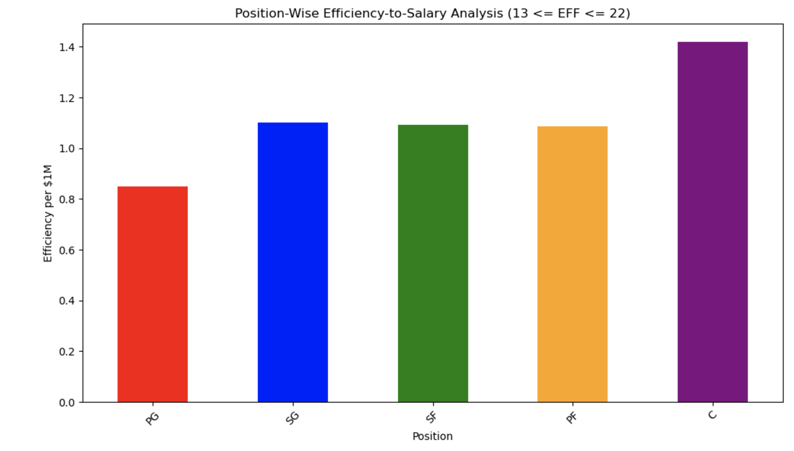
Finding #3
Notes:
How should GM evaluate their team. THis chart would help. The chart analyzes the Efficiency-to-Salary ratio for players grouped by position (PG, SG, SF, PF, C). This ratio represents the amount of efficiency (NBA_EFF) a team gets per $1 million spent on player salaries. It helps identify which positions offer the best value for the money and highlights potential inefficiencies in spending.
Key Insights:
Centers (C) Provide the Best Value:
Centers have the highest Efficiency-to-Salary ratio compared to other positions.
This indicates that teams are getting the most "bang for their buck" from Centers in terms of efficiency relative to their salary.
Point Guards (PG) Provide the Lowest Value:
Point Guards have the lowest Efficiency-to-Salary ratio, meaning they tend to be the most expensive relative to the efficiency they contribute.
This could indicate that teams might be overspending on Point Guards for their contribution.
Small and Power Forwards (SF and PF) Are in the Middle:
Small Forwards (SF) and Power Forwards (PF) offer moderate value, neither being significantly overpaid nor underpaid relative to their efficiency.
Shooting Guards (SG) Show Balanced Value:
Shooting Guards have a slightly better Efficiency-to-Salary ratio than PGs but are not as cost-effective as Centers.
Now these are obviously average values, so players could be performing better, but great starting point for GM to consider their team members relative
Strategic Implications:
Focus on Centers: Investing in quality Centers could be a cost-effective strategy for improving team performance.
Reassess Spending on Point Guards: Consider evaluating Point Guards’ contributions more critically to ensure their high salaries are justified.
Evaluate Forward Positions: Small Forwards and Power Forwards seem to provide balanced value, but individual players’ contracts might still need optimization.

Slide 16
Insights
An Actionable Plan for General Managers

Slide 17
GM Action Steps
Adjust Budget
Apply EFF
Team Improvement (Add, Subtract, Develop)
Positional Analysis
Step 1
Step 3
Market Share
Step 2
Step 4
Player Spread
Evaluating Team Market
Team Evaluation
Notes:
Step 1: Evaluate the Market
Action: Assess the team’s market size (Big, Mid, Small) and its impact on team performance, salary budget, and player retention.
Big Market: Leverage financial flexibility to attract and retain star players.
Small/Mid Market: Focus on undervalued players with high efficiency-to-salary ratios to stay competitive.
Step 2: Positional Analysis
Action: Analyze each position for cost-effectiveness and identify inefficiencies.
Centers: Provide the best efficiency-to-salary value—prioritize retaining or acquiring.
Point Guards: Reassess spending; avoid overpaying unless they are top-tier contributors.
Forwards: Focus on versatile players who can contribute across multiple categories (e.g., scoring, rebounding, defense).
Step 3: Evaluate the Current Team
Action: Identify strengths, weaknesses, and inefficiencies in the roster.
High Value Players: Extend contracts for young, efficient players (e.g., players under rookie contracts with high ACE scores).
Underperformers: Target high-salary players with low efficiency-to-salary ratios for trade or release.
Step 4: Improve the Team (Addition and Subtraction)
Action: Build the roster strategically through signings, trades, and development.
Addition: Target undervalued players in free agency or trades to fill gaps.
Subtraction: Trade or release overpaid underperformers to free up cap space.
Development: Provide more opportunities to young, high-value players (e.g., rookies) to accelerate their contributions.

Slide 18

Thanks!
&
Q/A

